Slide 1

Project
Gym Management System
Team members:
Batool Zehra (BAI-23F-059)
Ahmer Ali (BAI-23F-009)
Zainab Tariq(BAI-23F-011)
Farayha Mehmood(BAI-23F-069)
Course Instructor: Sir Khuda Buksh Brohi

Slide 2
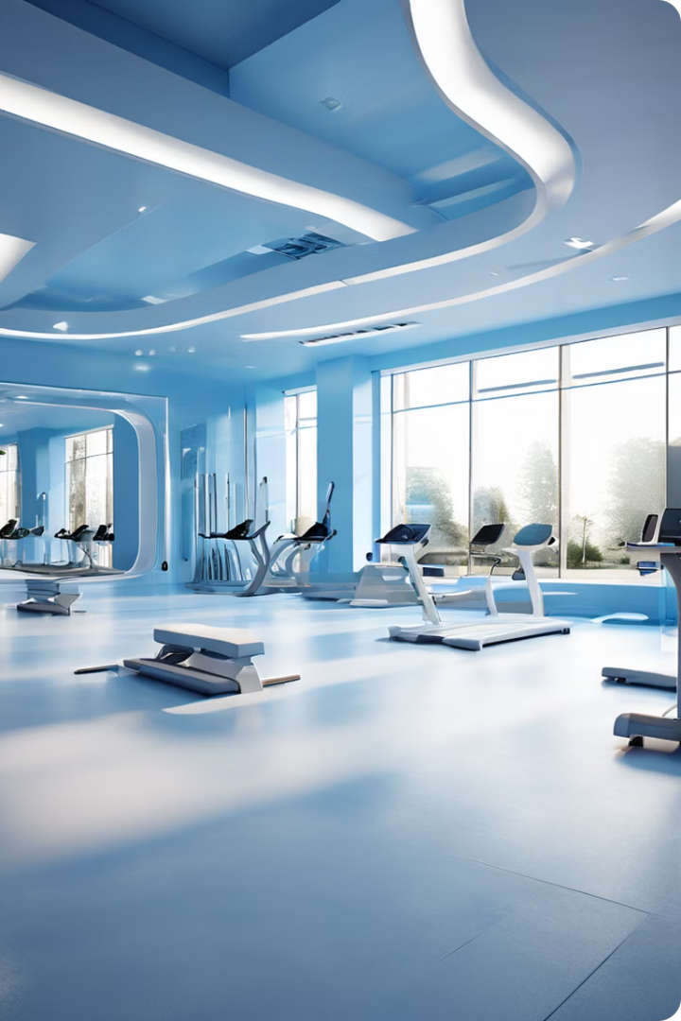
Introducing our Gym Management System
Designing a Gym Management System (GMS) involoves creating a comprehensive solution to handle various administrative, operational and member-related task within a gym or fItness center.Here is a detail of key components and functionalities that a robust gym management system should encompass.

Slide 3
User Management
Member Profiles
Access Control
Communication
Maintain detailed member profiles with contact information, fitness goals, and activity history.
Manage member access to the gym facility through secure check-in and authorization processes.
Seamlessly communicate with members through email, SMS, and in-app notifications for updates and announcements.

Slide 4
Membership Management
1
Registration
Streamline the membership registration process with online signup and automated enrollment.
2
Membership Plans
Offer a variety of membership plans to cater to different needs and budgets.
3
Renewals
Manage seamless membership renewals and track expiration dates to ensure members stay engaged.

Slide 5
Payment Management
Secure Transactions
Invoicing
Implement secure payment gateways to process memberships, class packages, and other gym-related purchases.
Generate professional invoices and receipts for members, keeping financial records organized.
Reporting
Recurring Billing
Monitor revenue, payment trends, and outstanding balances through comprehensive reporting tools.
Automate recurring membership payments to ensure a steady cash flow and reduce administrative tasks.

Slide 6




Inventory Management
Equipment
Supplies
Merchandise
Reporting
Track the availability, maintenance, and replacement schedule of all gym equipment.
Manage inventory levels of essential gym supplies, such as towels, water bottles, and first aid kits.
Monitor the stock and sales of gym-branded merchandise, apparel, and supplements.
Generate detailed reports on inventory levels, usage, and purchasing trends.

Slide 7
Key Components
1
Entity-Relationship Diagram (ERD)
2
Python Programming
A comprehensive visual representation of the database structure and relationships.
The primary language used for building the gym management system's functionality.
3
Tkinter GUI
4
MySQL Database
The Python GUI toolkit that provides a user-friendly interface for the system.
The relational database management system that stores and manages all gym-related data.

Slide 8
Conclusion
Our comprehensive gym management system is the ultimate solution for streamlining your fitness operations and enhancing the member experience. With its powerful tools and seamless integration, you can focus on growing your business and empowering your community to achieve their fitness goals.

Slide 9
THANK YOU!

